Slide 1

01
AI IN CYBERSECURITY
How AI Is Transforming Both Attackers and Defenders
By: Naskanti Sathvika
AI × CYBERSECURITY

Slide 2
02
01 THE NEW CYBER BATTLEFIELD
AI is changing the economics of cyber attacks and defense.
• Attackers: faster reconnaissance, social engineering, malware adaptation
• Defenders: faster detection, triage, investigation and response
• The advantage shifts to teams that combine AI + human judgment
AI × CYBERSECURITY | NASKANTI SATHVIKA

Slide 3
03
02 WHY AI CHANGES THE GAME
Traditional security is often constrained by human speed.
AI can process huge volumes of logs, identities, endpoints and threat intelligence.
Key shift:
Manual → assisted → automated → agentic workflows
But automation without controls can amplify mistakes at machine speed.
AI × CYBERSECURITY | NASKANTI SATHVIKA

Slide 4
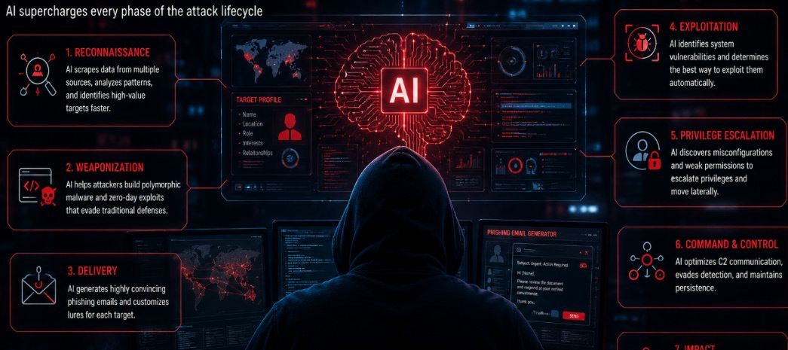
04
03 HOW ATTACKERS USE AI
• Reconnaissance: summarize public information and map attack surfaces
• Phishing & social engineering: personalize messages at scale
• Malware development: accelerate code generation and debugging
• Evasion: rapidly test defensive assumptions and modify techniques
• Fraud: generate convincing text, voice and synthetic media
Defensive lesson: assume adversaries can scale faster than before.
AI × CYBERSECURITY | NASKANTI SATHVIKA

Slide 5
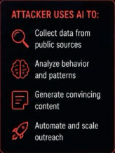
05
04 AI-POWERED SOCIAL ENGINEERING
The attack is no longer only technical.
AI can help attackers create:
• Highly personalized phishing
• Multilingual lures
• Synthetic voice/video impersonation
• Convincing business-email narratives
Defender response:
Identity verification + phishing-resistant MFA + behavioral analytics + awareness.
AI × CYBERSECURITY | NASKANTI SATHVIKA

Slide 6

06
05 AI FOR DEFENDERS
High-value defensive use cases:
• SOC alert triage and prioritization
• Threat-intelligence summarization
• Detection engineering assistance
• Incident timeline reconstruction
• Malware / log analysis assistance
• Security-control monitoring
• Analyst copilots for investigation
Goal: reduce analyst workload—not remove analysts.
AI × CYBERSECURITY | NASKANTI SATHVIKA

Slide 7
07
06 AI IN THE SOC
A practical AI-assisted SOC flow:
Telemetry → Detection → AI enrichment → Analyst validation → Response → Learning
AI can correlate:
Identity + endpoint + network + cloud + email + threat intelligence
Human approval remains critical for high-impact actions.
AI × CYBERSECURITY | NASKANTI SATHVIKA

Slide 8

08
07 DETECTION & THREAT HUNTING
AI can identify patterns that are difficult to spot manually:
• Unusual login behavior
• Lateral movement patterns
• Rare process execution
• Abnormal data access
• Suspicious relationships across entities
Best practice: combine AI signals with deterministic rules and context.
AI × CYBERSECURITY | NASKANTI SATHVIKA

Slide 9
09
08 INCIDENT RESPONSE WITH AI
AI can accelerate the investigation by:
1. Summarizing the incident
2. Building a timeline
3. Linking indicators and affected assets
4. Suggesting investigation paths
5. Drafting containment steps
6. Producing an executive summary
Never let a model's confidence substitute for evidence.
AI × CYBERSECURITY | NASKANTI SATHVIKA

Slide 10
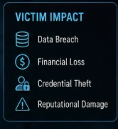
10
09 AI ALSO CREATES NEW RISKS
Security teams must defend the AI itself.
• Prompt injection
• Sensitive-data leakage
• Model manipulation / poisoning
• Excessive agent permissions
• Insecure tool use
• Hallucinated security conclusions
• Supply-chain risk in models and plugins
New attack surface = Model + Data + Tools + Identity + Workflow
AI × CYBERSECURITY | NASKANTI SATHVIKA

Slide 11
11
10 AGENTIC AI: THE NEXT SHIFT
An AI agent can perceive, reason, use tools and act.
Example security agent:
Detect alert → query SIEM → enrich IOC → investigate endpoint → recommend containment
Power increases when agents receive write access.
Design principle:
Least privilege + approval gates + audit logs + sandboxing.
AI × CYBERSECURITY | NASKANTI SATHVIKA

Slide 12
12
11 AI GOVERNANCE FOR SECURITY TEAMS
A practical governance checklist:
• Define approved AI use cases
• Classify data before sending it to AI
• Establish human-approval boundaries
• Log prompts, outputs and actions where appropriate
• Test for prompt injection and data leakage
• Measure accuracy, false positives and business impact
• Review vendors, models and integrations
AI × CYBERSECURITY | NASKANTI SATHVIKA

Slide 13
13
12 THE AI SECURITY STACK
Think in layers:
DATA → MODEL → APPLICATION → AGENT → TOOLS → IDENTITY → INFRASTRUCTURE
Each layer needs:
Visibility | Access control | Validation | Monitoring | Incident response
Security is no longer only about protecting endpoints and networks.
AI × CYBERSECURITY | NASKANTI SATHVIKA

Slide 14

14
13 ATTACKER vs DEFENDER
ATTACKERS
• Scale persuasion
• Automate reconnaissance
• Adapt faster
• Lower technical barriers
DEFENDERS
• Correlate more data
• Automate triage
• Detect behavioral anomalies
• Accelerate response
The winner is not “AI.”
The winner is the side with better data, controls, workflows and people.
AI × CYBERSECURITY | NASKANTI SATHVIKA

Slide 15
15
14 WHAT CYBERSECURITY PROFESSIONALS SHOULD DO NOW
1. Learn AI fundamentals
2. Use copilots safely for repetitive work
3. Build prompt + verification discipline
4. Understand AI-specific threats
5. Add AI security to risk assessments
6. Automate low-risk workflows first
7. Keep humans accountable for high-impact decisions
AI × CYBERSECURITY | NASKANTI SATHVIKA

Slide 16
16
15 DISCUSSION
From alert to investigation in minutes
Show a safe, simulated SOC alert and demonstrate:
• AI summarization
• IOC extraction
• MITRE ATT&CK mapping
• Investigation questions
• Analyst validation
• Incident-report drafting
AI × CYBERSECURITY | NASKANTI SATHVIKA

Slide 17
17
16 KEY TAKEAWAYS
AI is not replacing cybersecurity professionals.
It is changing what “good cybersecurity” looks like.
Attackers use AI to scale.
Defenders use AI to accelerate.
Security teams must also secure AI itself.
The future belongs to professionals who can combine:
CYBERSECURITY + AI + GOVERNANCE + HUMAN JUDGMENT
AI × CYBERSECURITY | NASKANTI SATHVIKA

Slide 18
18
Q&A
Thank you.
AI × CYBERSECURITY | NASKANTI SATHVIKA

